Slide 1
UNIT-5
Part:1RISC and CISC
Part:2 Vector processing and Pipelining
Part:3 Multiprocessors

Slide 2
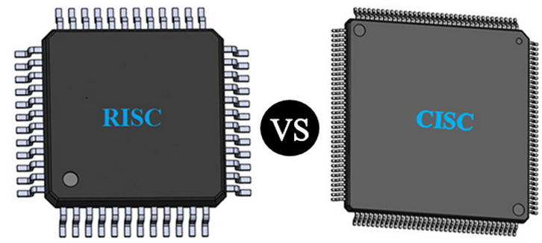

Slide 3
Reduced Instruction Set Architecture (RISC)
Reduced Instruction Set Computing (RISC) is a computer architecture that emphasizes a simple and efficient instruction set.
RISC processors have a smaller instruction set than CISC processors, with each instruction performing a single operation.
The goal of RISC architecture is to reduce the amount of work the processor needs to do for each instruction, which leads to faster and more efficient processing.

Slide 4
RISC
RISC processors often use pipe-lining to achieve greater performance.
Pipe-lining involves breaking down the execution of an instruction into smaller stages, so multiple instructions can be executed simultaneously.
This reduces the overall execution time for a program, as each stage of the pipeline can be devoted to a different instruction.

Slide 5
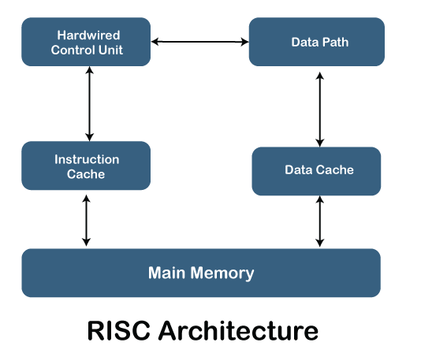

Slide 6
Example: RISC processors include the ARM, MIPS, and PowerPC architectures
The ARM architecture is used in many smartphones and tablets, while the MIPS architecture is commonly used in embedded systems such as routers and set-top boxes.
The PowerPC architecture was used in Apple's Power Macintosh computers before they switched to Intel processors.

Slide 7
Characteristics of RISC
Simpler instruction, hence simple instruction decoding.
Instruction comes undersize of one word.
Instruction takes a single clock cycle to get executed.
More general-purpose registers.
Simple Addressing Modes.
Fewer Data types.
A pipeline can be achieved.

Slide 8
Advantages of RISC
Simpler instructions: RISC processors use a smaller set of simple instructions, which makes them easier to decode and execute quickly. This results in faster processing times.
Faster execution: Because RISC processors have a simpler instruction set, they can execute instructions faster than CISC processors.
Lower power consumption: RISC processors consume less power than CISC processors, making them ideal for portable devices.

Slide 9
Disadvantages of RISC
More instructions required: RISC processors require more instructions to perform complex tasks than CISC processors.
Increased memory usage: RISC processors require more memory to store the additional instructions needed to perform complex tasks.
Higher cost: Developing and manufacturing RISC processors can be more expensive than CISC processors.

Slide 10
Complex Instruction Set Architecture (CISC)
Complex Instruction Set Computing (CISC) is a computer architecture that emphasizes a large and complex instruction set.
CISC processors have many instructions that can perform multiple operations in a single instruction.
The goal of CISC architecture is to reduce the number of instructions a program needs to execute, which can lead to faster program execution
can also lead to slower processing times.

Slide 11
CISC
CISC processors typically have more extensive hardware support for performing complex instructions.
This allows for more sophisticated operations to be performed in a single instruction, which can lead to faster program execution. However, the increased complexity

Slide 12
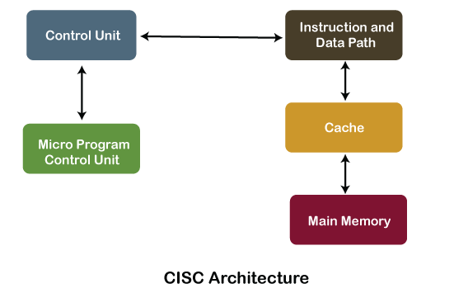

Slide 13
Example: CISC processors include the x86 architecture used in most desktop and laptop computers today.
The x86 architecture includes instructions that can perform complex tasks such as string manipulation, as well as instructions that can access and modify system memory directly.

Slide 14
Characteristics of CISC
Complex instruction, hence complex instruction decoding.
Instructions are larger than one-word size.
Instruction may take more than a single clock cycle to get executed.
Less number of general-purpose registers as operations get performed in memory itself.
Complex Addressing Modes.
More Data types.

Slide 15
Advantages of CISC
Reduced code size: CISC processors use complex instructions that can perform multiple operations, reducing the amount of code needed to perform a task.
More memory efficient: Because CISC instructions are more complex, they require fewer instructions to perform complex tasks, which can result in more memory-efficient code.
Widely used: CISC processors have been in use for a longer time than RISC processors, so they have a larger user base and more available software.

Slide 16
Disadvantages of CISC
Slower execution: CISC processors take longer to execute instructions because they have more complex instructions and need more time to decode them.
More complex design: CISC processors have more complex instruction sets, which makes them more difficult to design and manufacture.
Higher power consumption: CISC processors consume more power than RISC processors because of their more complex instruction sets.

Slide 17
RISC | CISC
Focus on software | Focus on hardware
Uses only Hardwired control unit | Uses both hardwired and microprogrammed control unit
Transistors are used for more registers | Transistors are used for storing complex Instructions
Fixed sized instructions | Variable sized instructions
Can perform only Register to Register Arithmetic operations | Can perform REG to REG or REG to MEM or MEM to MEM
Requires more number of registers | Requires less number of registers
Code size is large | Code size is small
An instruction executed in a single clock cycle | Instruction takes more than one clock cycle
An instruction fit in one word. | Instructions are larger than the size of one word
Simple and limited addressing modes. | Complex and more addressing modes.
RISC is Reduced Instruction Cycle. | CISC is Complex Instruction Cycle.
The number of instructions are less as compared to CISC. | The number of instructions are more as compared to RISC.
It consumes the low power. | It consumes more/high power.
RISC is highly pipelined. | CISC is less pipelined.
RISC required more RAM. | CISC required less RAM.
Here, Addressing modes are less. | Here, Addressing modes are more.

Slide 18
CISC versus RISC
CISC | RISC
Emphasis on hardware | Emphasis on software
Includes multi-clock complex instructions | Single-clock, reduced instruction only
Memory-to-memory: "LOAD" and "STORE" incorporated in instructions | Register to register: "LOAD" and "STORE" are independent instructions
Small code sizes, high cycles per second | Low cycles per second, large code sizes
Transistors used for storing complex instructions | Spends more transistors on memory registers

Slide 19
Parallel Processing

Slide 20
Parallel Processing
Parallel processing is a technique which enables the system to achieve simultaneous data-processing tasks to increase the computational speed of a computer system.

Slide 21
Parallel Processing
A parallel processing system can carry out simultaneous data-processing to achieve faster execution time.
For instance, while an instruction is being processed in the ALU component of the CPU, the next instruction can be read from memory.

Slide 22
The primary purpose of parallel processing is to enhance the computer processing capability and increase its throughput, i.e. the amount of processing that can be accomplished during a given interval of time.
A parallel processing system can be achieved by having a multiplicity of functional units that perform identical or different operations simultaneously. The data can be distributed among various multiple functional units.

Slide 23
Parallel Processing
The following diagram shows one possible way of separating the execution unit into eight functional units operating in parallel.
The operation performed in each functional unit is indicated in each block if the diagram:

Slide 24
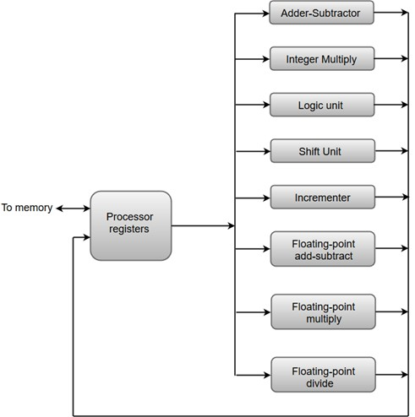

Slide 25
parallel processing
Playing a simple video game on a computer uses audio, images, calculations, rendering, etc.
If a single CPU handles all these things, it will take time to process them. On the other hand, using multiple CPUs to handle various jobs will work much more smoothly. This process of executing multiple tasks concurrently is called parallel processing.

Slide 26
Parallel processing is used to enhance the performance of a computer by performing multiple instructions simultaneously.
Unlike sequential processing, parallel architecture can divide a job into parts and multi-task them.
That means concurrent execution of instructions is possible. Thus, the computational speed of the computer will increase.

Slide 27
One of the significant components of the CPU is ALU (Arithmetic Logic Unit). It is helpful to execute any instruction on the computer.
ALU is divided into several functional units
The system may have two or more ALUs and can execute multiple instructions simultaneously.
The system may have multiple processors operating simultaneously.

Slide 28
FLYNN‘S CLASSIFICATION
Flynn's taxonomy is a specific classification of parallel computer architectures that are based on the number of concurrent instruction (single or multiple) and data streams (single or multiple) available in thearchitecture.
The four categories in Flynn's taxonomy are thefollowing:
1. (SISD) single instruction, singledata
2. (SIMD) single instruction, multipledata
3. (MISD) multiple instruction, singledata
4. (MIMD) multiple instruction, multipledata

Slide 29
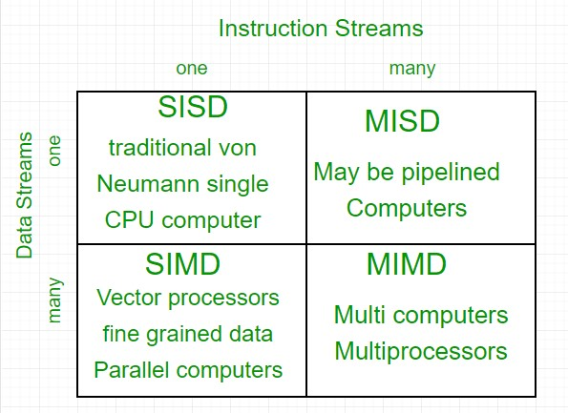

Slide 30
SISD
An SISD computing system is a uniprocessor machine which is capable of executing a single instruction, operating on a single datastream.
In SISD, machine instructions are processed in a sequential manner and computers adopting this model are popularly called sequentialcomputers.
Most conventionalcomp data to be processed have to be stored in primary memory.

Slide 31
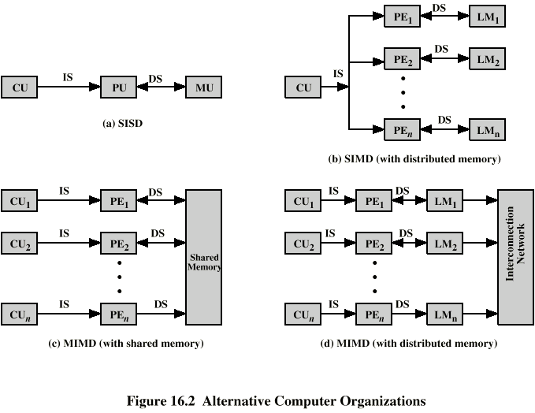
SISD

Slide 32
SIMD

Slide 33
MIMD

Slide 34

PIPELINING

Slide 35
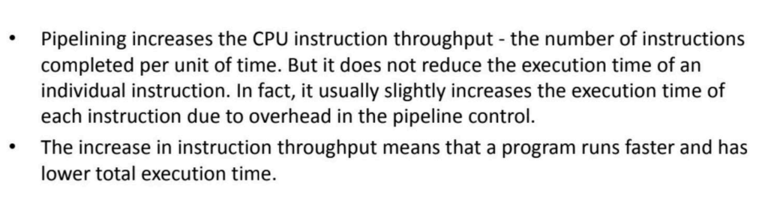

Slide 36
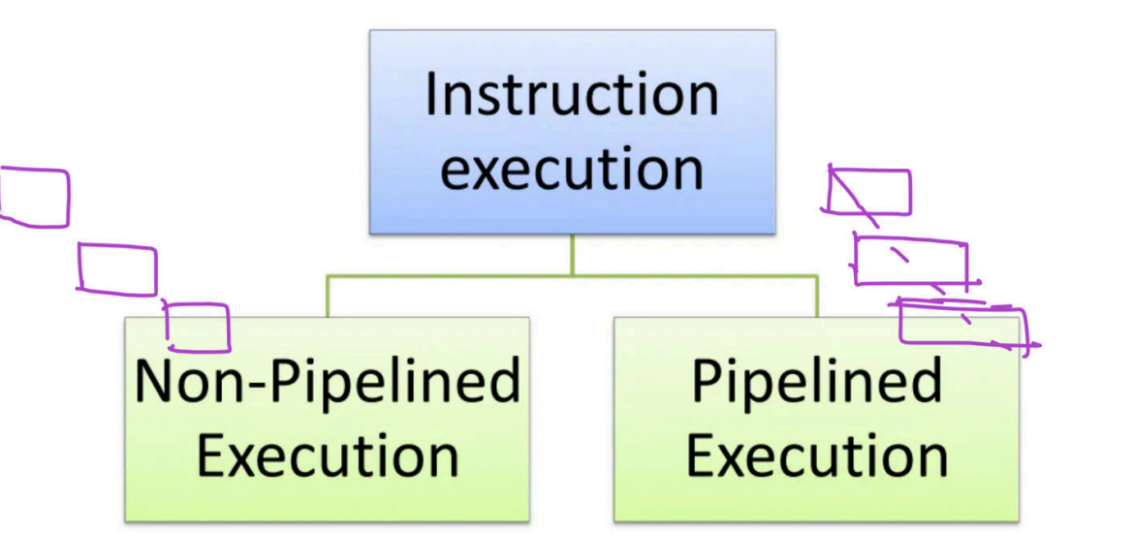

Slide 37
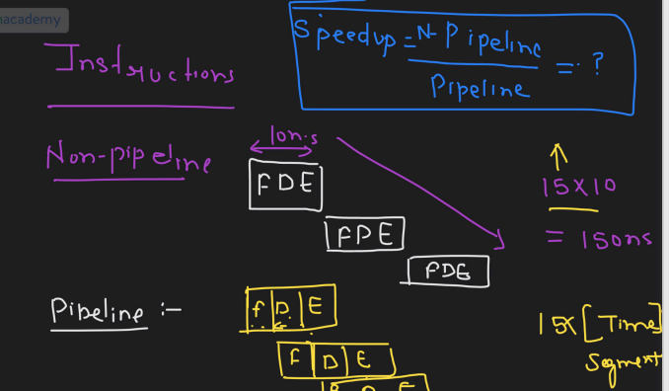

Slide 38
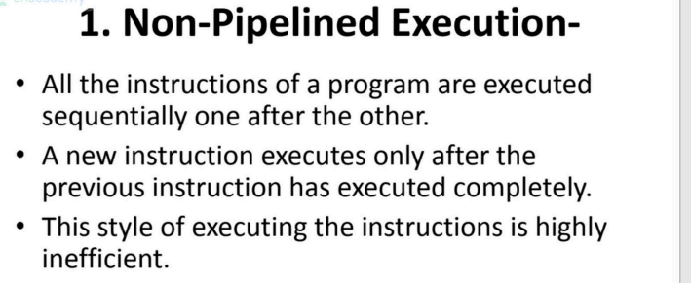


Slide 39
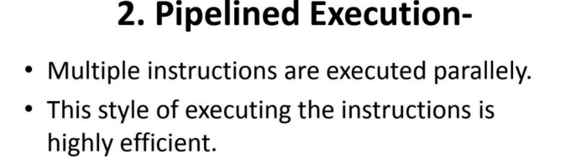
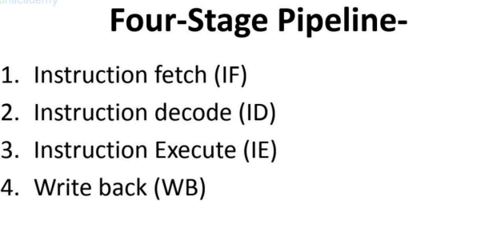

Slide 40
PROBLEM

Slide 41
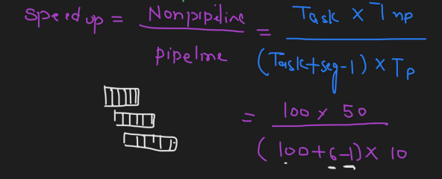

Slide 42
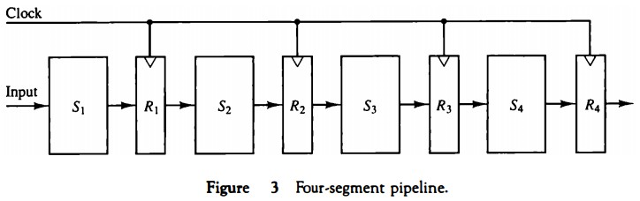
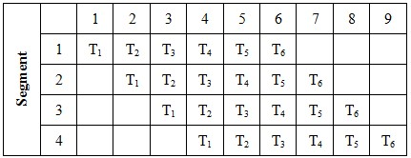

Slide 43
pipelining Vs parallel..
Pipelining results in faster processing because the CPU does not have to wait for one instruction to complete the machine cycle. While Parallel processing is a method in computing of running two or more processors (CPUs) to handle separate parts of an overall task.

Slide 44
The combined multiplication and addition operation is done with a stream of numbers such as:
A_{i}* B_{i} + C_{i} for i = 1, 2, 3, ......., 7

Slide 45
The operation to be performed on the numbers is decomposed into sub-operations with each sub-operation to be implemented in a segment within a pipeline.
The sub-operations performed in each segment of the pipeline are defined as:
R1 ← A_{i}, R2 ← B_{i} Input A_{i}, and B_{i}
R3 ← R1 * R2, R4 ← C_{i} Multiply, and inputC_{i}
R5 ← R3 + R4 Add C_{i} to product

Slide 46
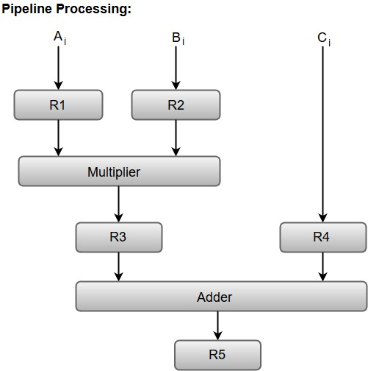

Slide 47
TYPES
Arithmetic Pipeline
Instruction pipeline

Slide 48
Arithmetic Pipeline
Arithmetic Pipelines are mostly used in high-speed computers.
They are used to implement floating-point operations, multiplication of fixed-point numbers, and similar computations encountered in scientific problems.

Slide 49
The combined operation of floating-point addition and subtraction is divided into four segments. Each segment contains the corresponding suboperation to be performed in the given pipeline.
The suboperations that are shown in the four segments are:
Compare the exponents by subtraction.
Align the mantissas.
Add or subtract the mantissas.
Normalize the result.

Slide 50
The inputs to the floating-point adder pipeline are two normalized floating-point binary numbers defined as:
X = A * 2ª = 0.9504 * 10³
Y = B * 2^{b} = 0.8200 * 10²
Where A and B are two fractions that represent the mantissa and a and b are the exponents.

Slide 51
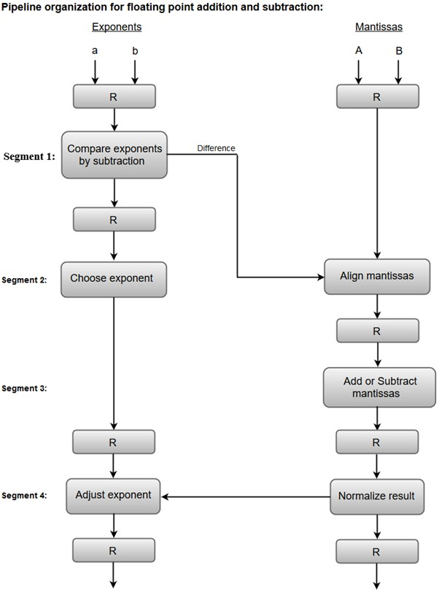

Slide 52
1. Compare exponents by subtraction:
The exponents are compared by subtracting them to determine their difference. The larger exponent is chosen as the exponent of the result.
The difference of the exponents, i.e., 3 - 2 = 1 determines how many times the mantissa associated with the smaller exponent must be shifted to the right.

Slide 53
2. Align the mantissas:
The mantissa associated with the smaller exponent is shifted according to the difference of exponents determined in segment one.
X = 0.9504 * 10³
Y = 0.08200 * 10³
3. Add mantissas:
The two mantissas are added in segment three.
Z = X + Y = 1.0324 * 10³
4. Normalize the result:
After normalization, the result is written as:
Z = 0.1324 * 10⁴

Slide 54
Instruction Pipeline
Most of the digital computers with complex instructions require instruction pipeline to carry out operations like fetch, decode and execute instructions.
In general, the computer needs to process each instruction with the following sequence of steps.
Fetch instruction from memory.
Decode the instruction.
Calculate the effective address.
Fetch the operands from memory.
Execute the instruction.
Store the result in the proper place.

Slide 55
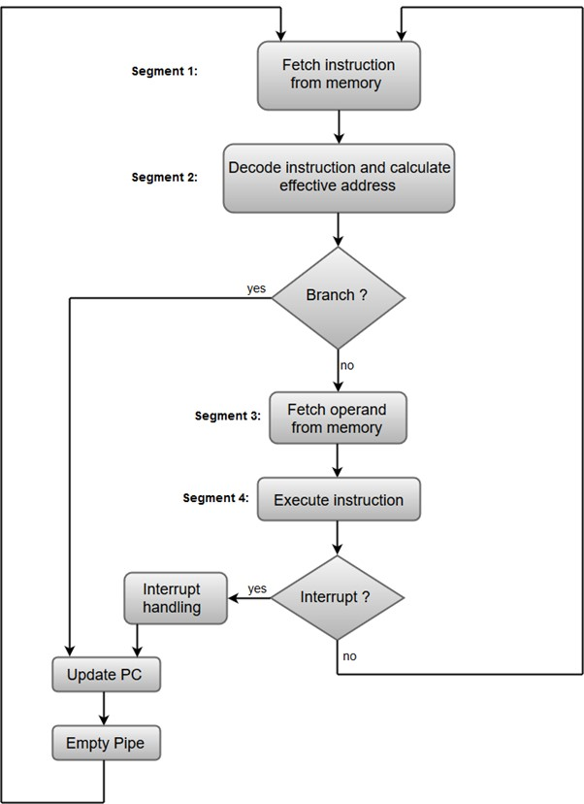

Slide 56
Segment 1:
The instruction fetch segment can be implemented using first in, first out (FIFO) buffer.
Segment 2:
The instruction fetched from memory is decoded in the second segment, and eventually, the effective address is calculated in a separate arithmetic circuit.
Segment 3:
An operand from memory is fetched in the third segment.
Segment 4:
The instructions are finally executed in the last segment of the pipeline organization.

Slide 57
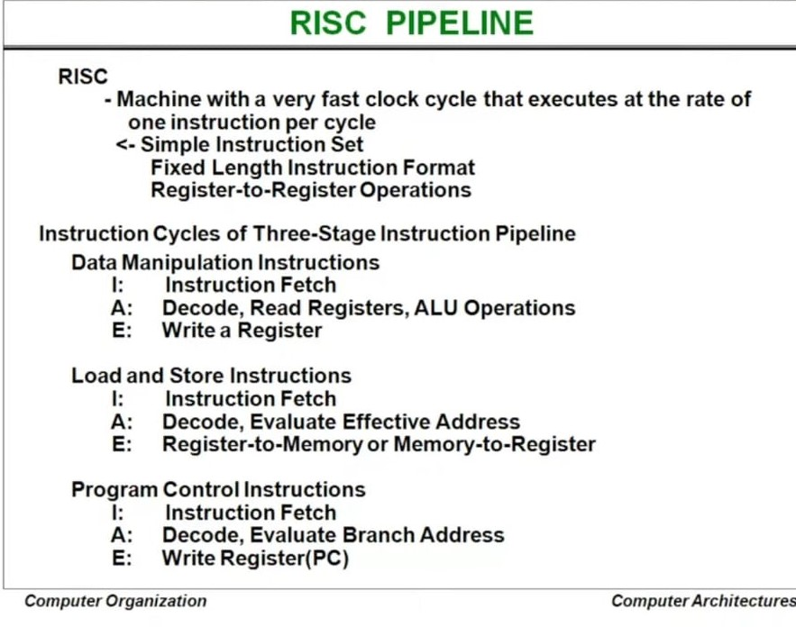

Slide 58
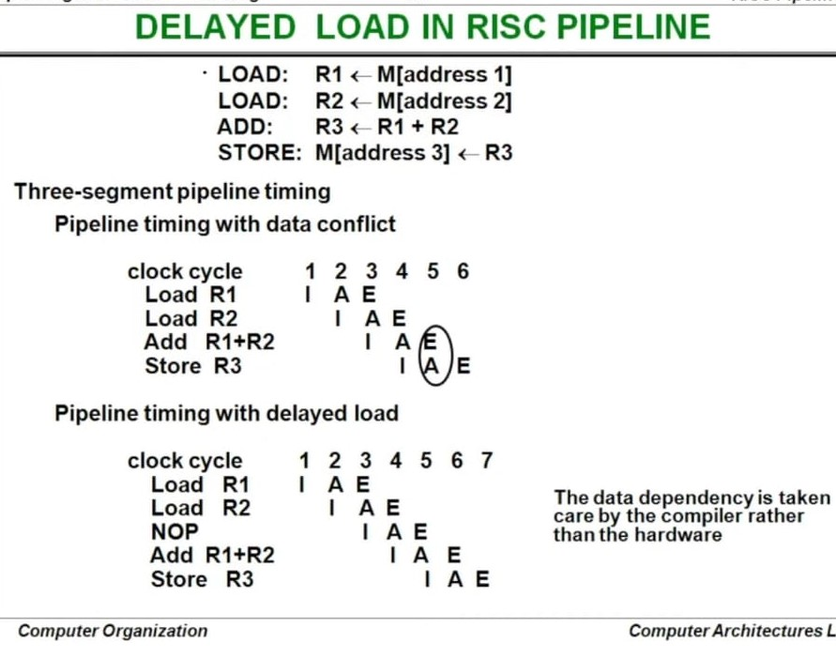

Slide 59
Vector Processing
In many science and engineering applications, the problems can be formulated in terms of vectors and matrices that lend themselves to vector processing.
Computers with vector processing capabilities are in demand in specialized applications.
Long-range weather forecasting
Petroleum explorations
Seismic data analysis
Medical diagnosis
Artificial intelligence and expert systems
Image processing
Mapping the human genome

Slide 60
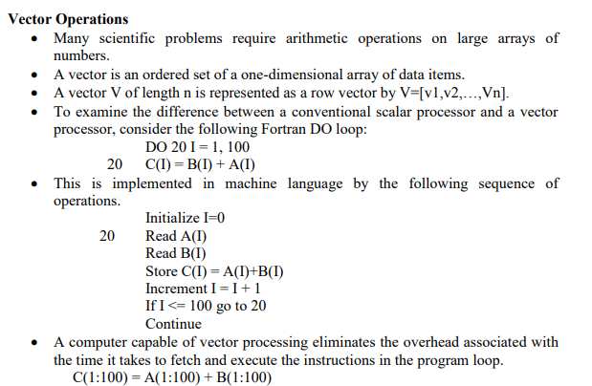

Slide 61

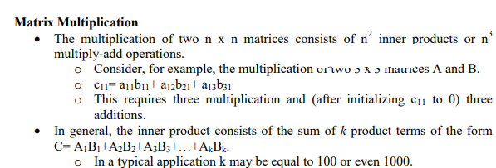

Slide 62
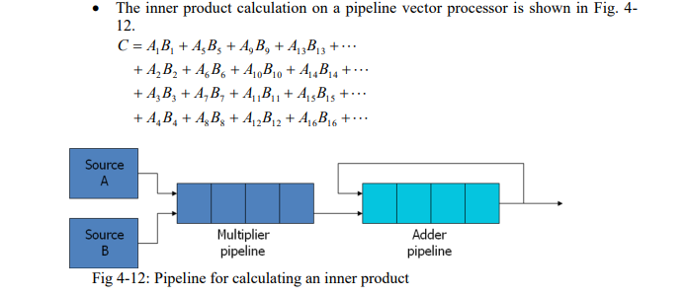

Slide 63
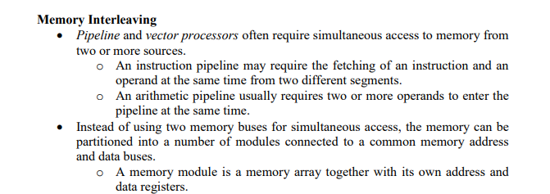
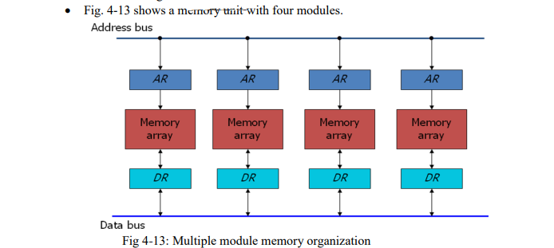

Slide 64
The advantage of a modular memory is that it allows the use of a technique called interleaving.
In an interleaved memory, different sets of addresses are assigned to different memory modules.
By staggering the memory access, the effective memory cycle time can be reduced by a factor close to the number of modules.

Slide 65
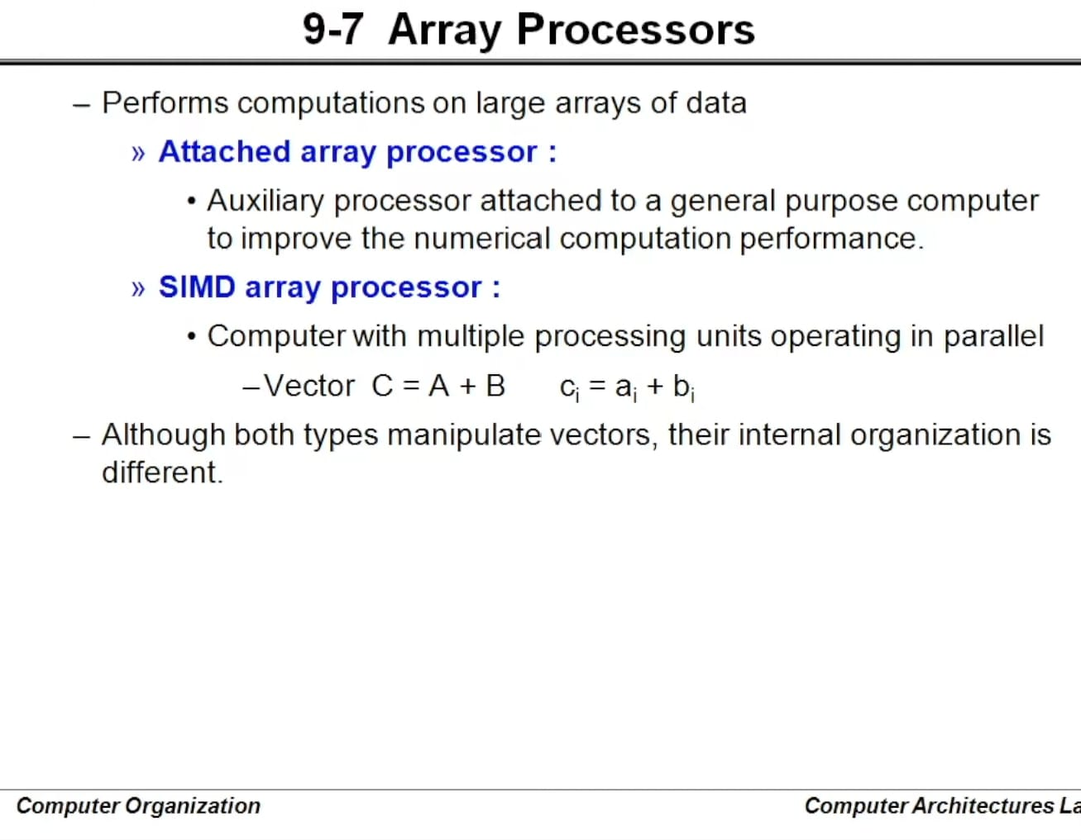

Slide 66
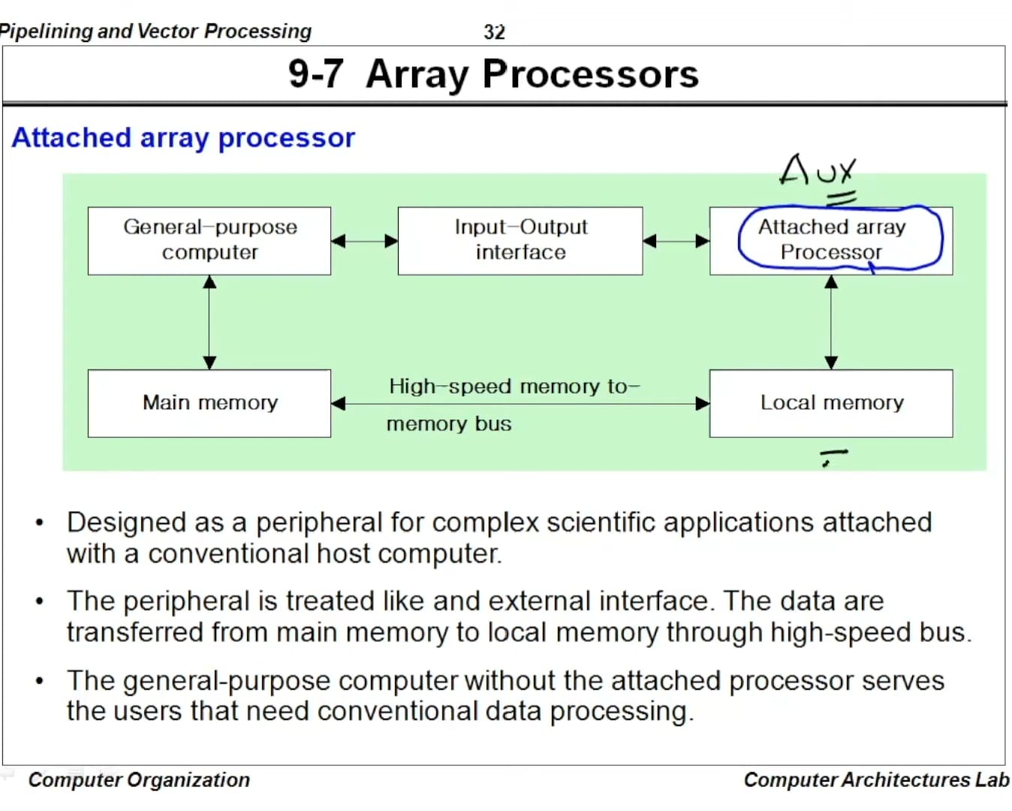

Slide 67
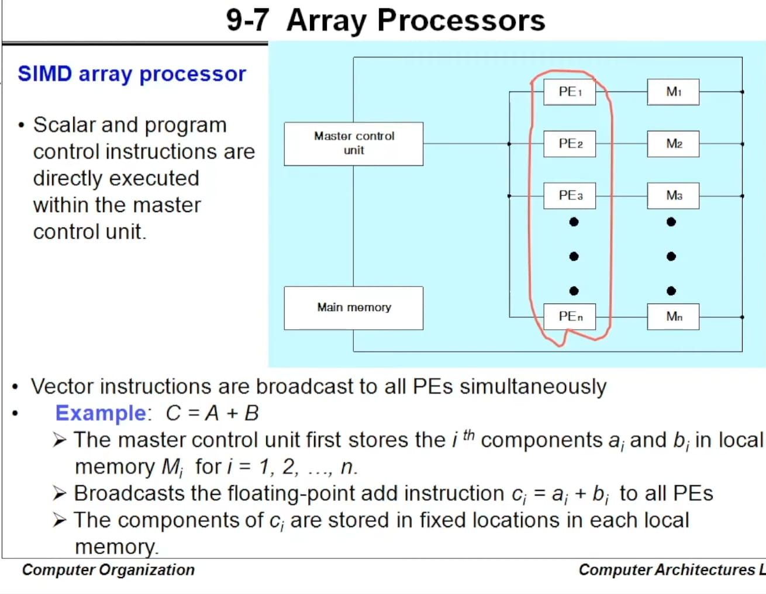

Slide 68
Multiprocessors
Two or more CPUs make up a multiprocessor system.
It’s a system that connects two or more CPUs with memory and I/O equipment.
The term “processor” can refer to either a central processing unit (CPU) or an input-output processor in a multiprocessor (IOP).
A system with a single CPU and one or more lOPs, on the other hand, is usually not considered a multiprocessor unless the IOP has computational capabilities comparable to a CPU.

Slide 69
A multiprocessor system, consists of numerous CPUs, with one or more lOPs .
Multiprocessors are categorised as MIMD (multiple instruction streams, multiple data stream) systems, as previously stated.

Slide 70
Advantages of Multiprocessor Systems
More reliable Systems
Increasing Throughout
More Economic Systems

Slide 71
Characteristics of Multiprocessor
Parallel Processing
Distributed Computing
Supercomputing
Pipelining
Vector Computing
systolic

Slide 72
Parallel Processing
This requires the use of many processors at the same time.
These processors are designed to do a particular task using a single architecture
Processors are generally identical, and they operate together to create the effect that the users are the only individuals who are using the system.

Slide 73
Distributed computing
distributed processing requires the use of a processor network.
Each processor in this network can be thought of as a standalone computer with the ability to solve problems.
These processors are diverse, and each one is typically assigned to a separate job.

Slide 74
Supercomputing
This involves the usage of the fastest machines to resolve big and computationally complex problems
Supercomputers used to be vector computers, but nowadays, most people accept vector or parallel computing.

Slide 75
Pipelining
Besides supercomputing, this is a method that divides a task into multiple subtasks that must be completed in a specified order.
Each subtask is aided by the functional units.
The devices are connected serially, and they all work at the same time.

Slide 76
Systolic
This is similar to pipelining, but units are not arranged in a linear order.
The steps in systolic are normally small and more in number and performed in a lockstep manner.
This is more frequently applied in special-purpose hardware such as image or signal processors.

Slide 77
Interconnection Structure
the components that form the multiprocessor system are CPU ,IOP connected to I/O devices , and memory unit that may be portioned into a number of separate modules.

Slide 78
Time-shared common bus
Multi-port memory
Crossbar switch
Multistage switching network
Hypercube system

Slide 79
Bus arbitration
In a computer system, multiple devices, such as the CPU, memory, and I/O controllers, are connected to a common communication pathway, known as a bus.
In order to transfer data between these devices, they need to have access to the bus.
Bus arbitration is the process of resolving conflicts that arise when multiple devices attempt to access the bus at the same time.

Slide 80
When multiple devices try to use the bus simultaneously, it can lead to data corruption and system instability.
To prevent this, a bus arbitration mechanism is used to ensure that only one device has access to the bus at any given time.

Slide 81
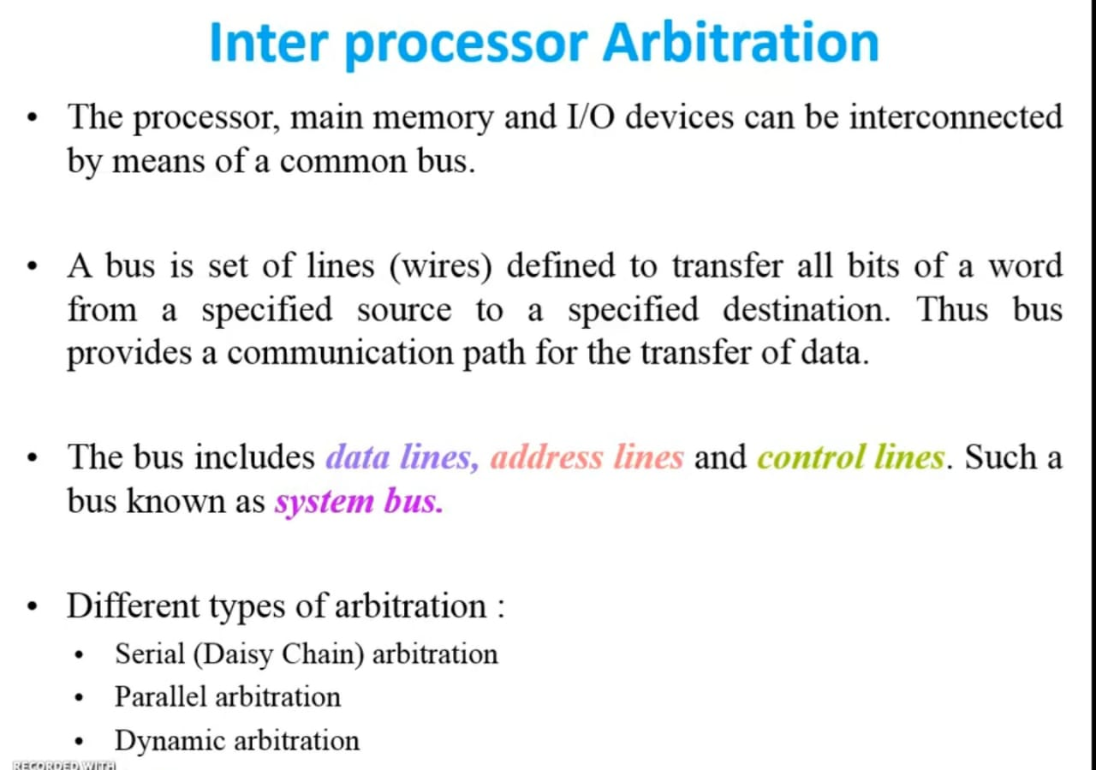

Slide 82
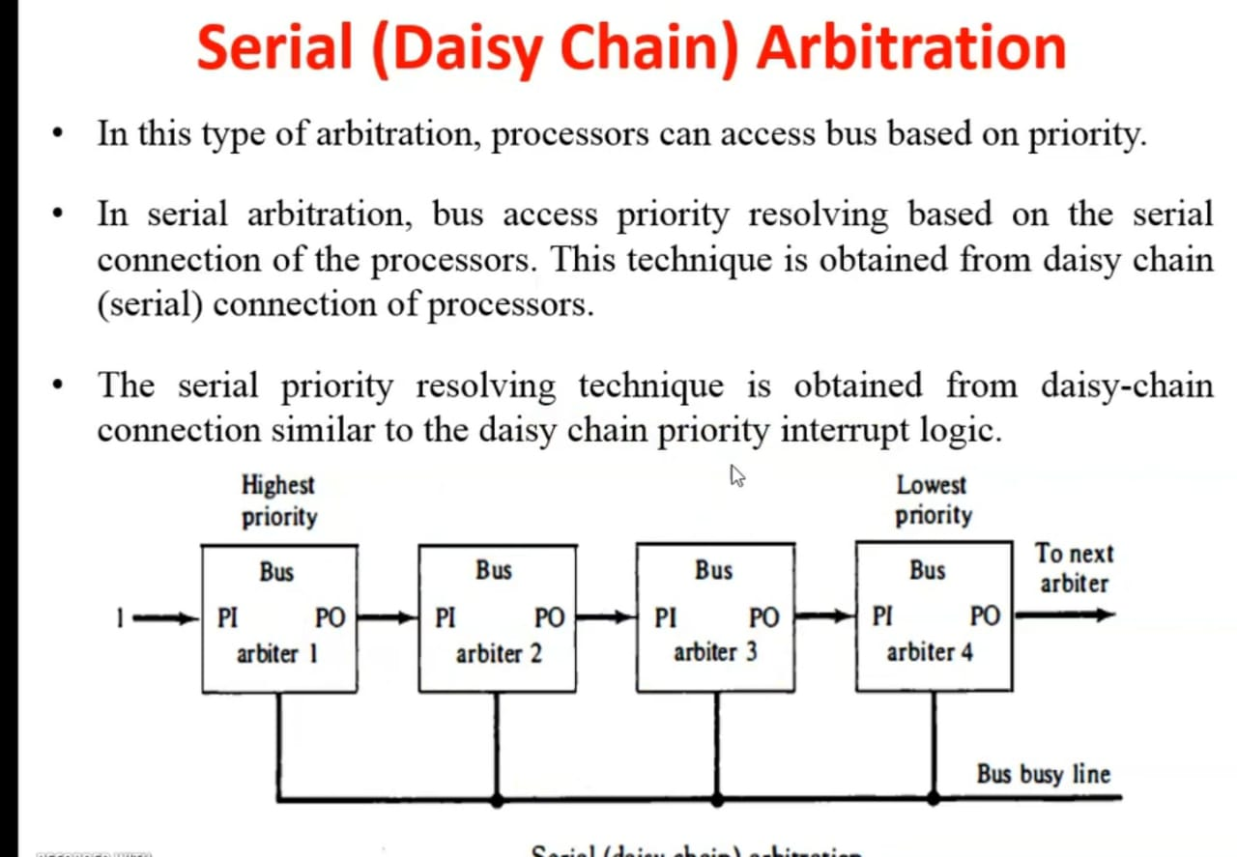

Slide 83
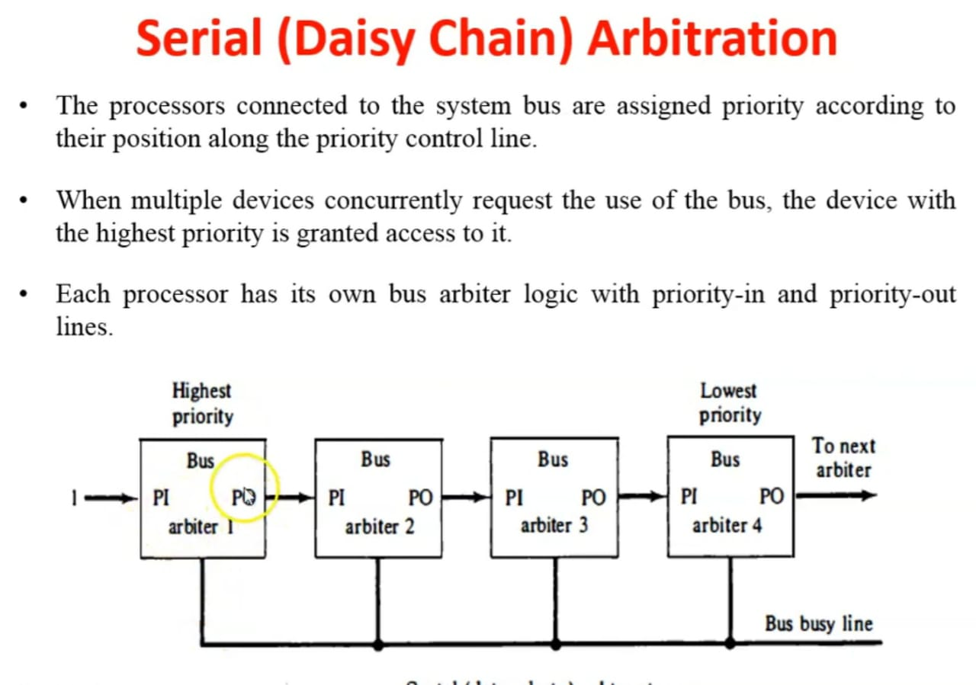

Slide 84
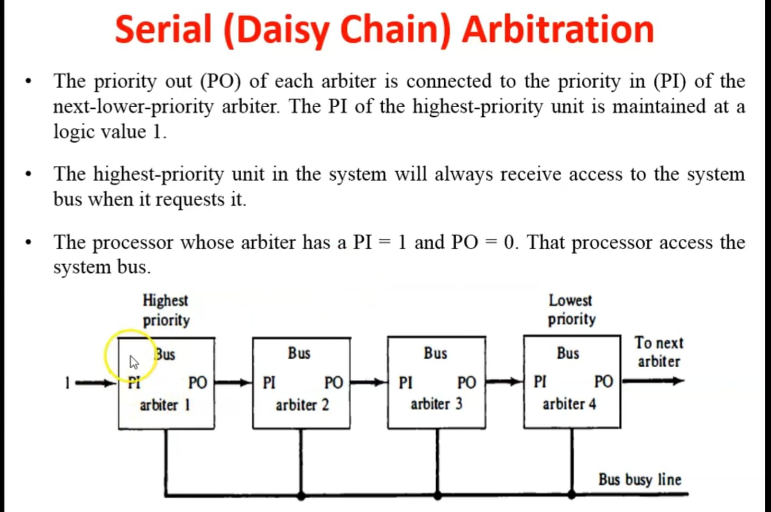

Slide 85
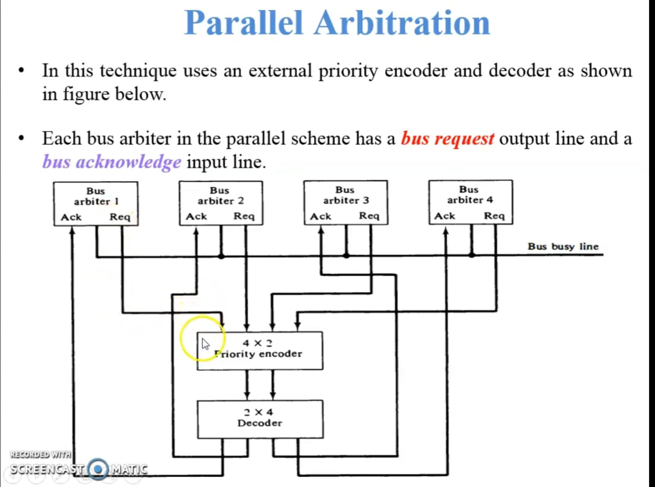

Slide 86
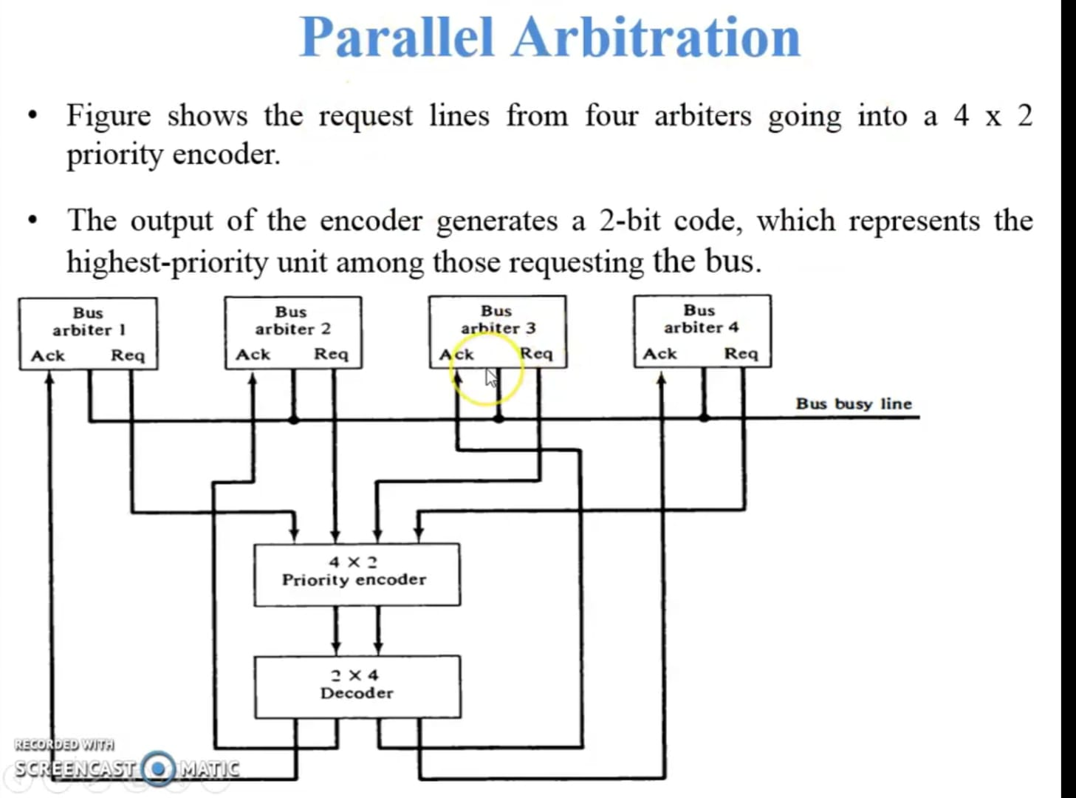

Slide 87
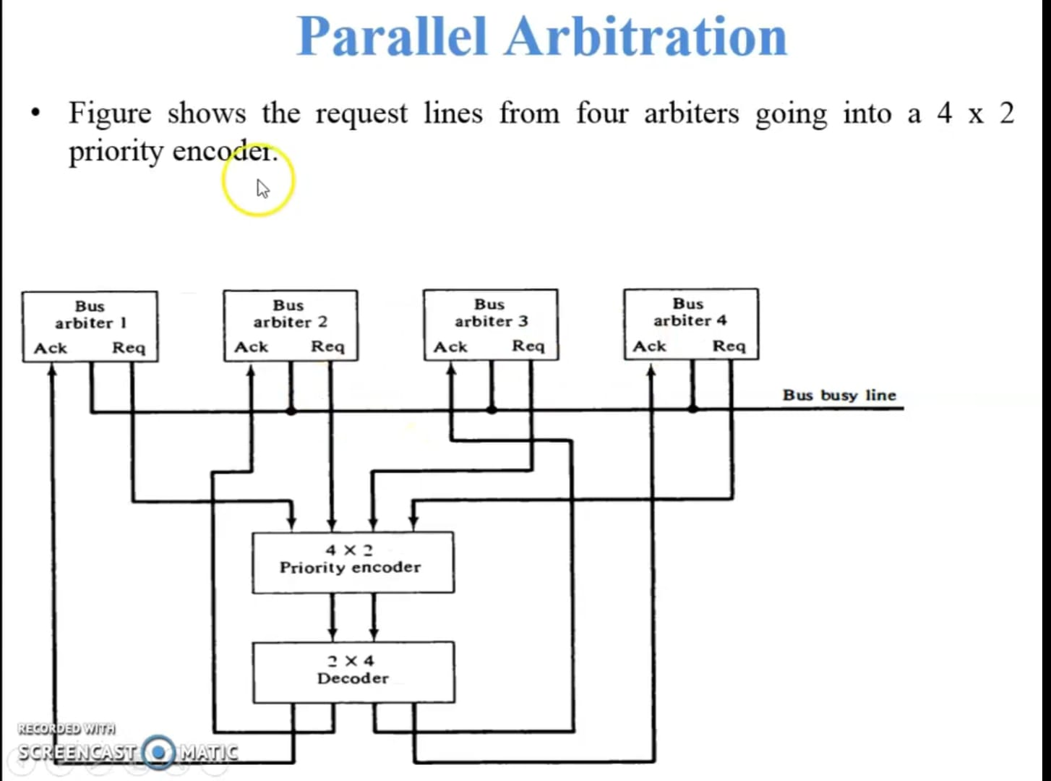

Slide 88
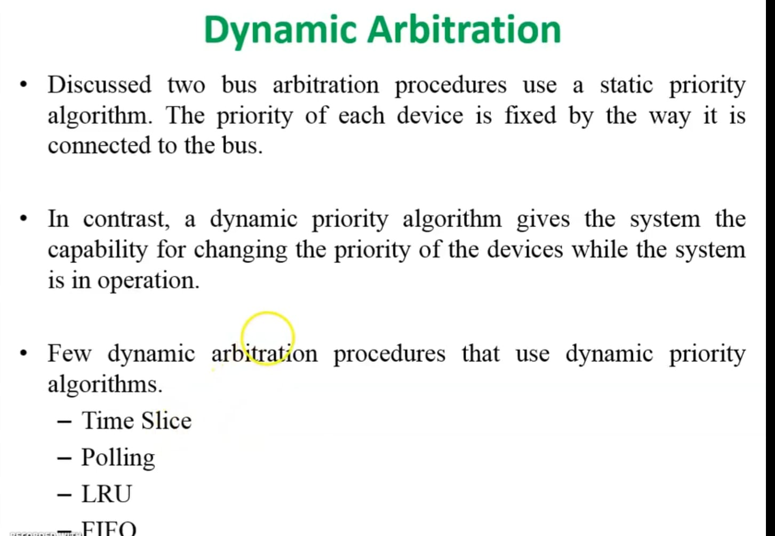

Slide 89
Inter Process Communication
In general, Inter Process Communication is a type of mechanism usually provided by the operating system (or OS).
The main aim or goal of this mechanism is to provide communications in between several processes.
In short, the intercommunication allows a process letting another process know that some event has occurred.

Slide 90
These are a few different approaches for Inter- Process Communication:
Pipes
Shared Memory
Message Queue
Direct Communication
Indirect communication
Message Passing
FIFO

Slide 91
Types
In centralized arbitration, a single device, known as the bus controller, is responsible for managing access to the bus.
In decentralized arbitration, each device has its own priority level, and the device with the highest priority is given access to the bus.
In distributed arbitration, devices compete for access to the bus by sending a request signal and waiting for a grant signal.

Slide 92
There are two approaches to bus arbitration:
Centralized bus arbitration –
A single bus arbiter performs the required arbitration.
Distributed bus arbitration –
All devices participating in the selection of the next bus master.

Slide 93

Daisy chain Arbitration

Slide 94
Cache Coherence
In a multiprocessor system, data inconsistency may occur among adjacent levels or within the same level of the memory hierarchy.
In a shared memory multiprocessor with a separate cache memory for each processor, it is possible to have many copies of any one instruction operand: one copy in the main memory and one in each cache, the other copies of the operand must be changed also.
Example : Cache and the main memory may have inconsistent copies of the same object.
Notes:
memory. When one copy of an operand is changed

Slide 95
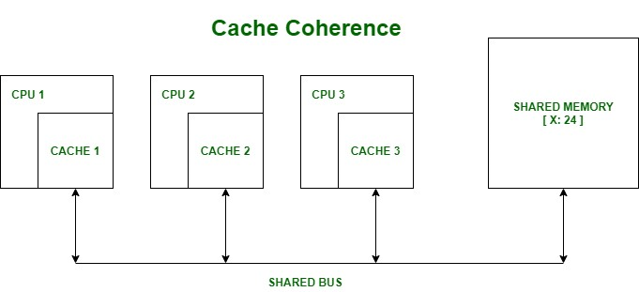

Slide 96
Suppose there are three processors, each having cache. Suppose the following scenario:-
Processor 1 read X : obtains 24 from the memory and caches it.
Processor 2 read X : obtains 24 from memory and caches it.
Again, processor 1 writes as X : 64, Its locally cached copy is updated. Now, processor 3 reads X, what value should it get?
Memory and processor 2 thinks it is 24 and processor 1 thinks it is 64

Slide 97
As multiple processors operate in parallel, and independently multiple caches may possess different copies of the same memory block, this creates a cache coherence problem.

Slide 98
There are various Cache Coherence Protocols in multiprocessor system.
These are :-
MSI protocol (Modified, Shared, Invalid)
MOSI protocol (Modified, Owned, Shared, Invalid)
MESI protocol (Modified, Exclusive, Shared, Invalid)
MOESI protocol (Modified, Owned, Exclusive, Shared, Invalid)

Slide 99
Modified – It means that the value in the cache is dirty, that is the value in current cache is different from the main memory.
Exclusive – It means that the value present in the cache is same as that present in the main memory, that is the value is clean.
Shared – It means that the cache value holds the most recent data copy and that is what shared among all the cache and main memory as well.
Owned – It means that the current cache holds the block and is now the owner of that block, that is having all rights on that particular blocks.
Invalid – This states that the current cache block itself is invalid and is required to be fetched from other cache or main memory.

Slide 100
Methods to resolve Cache Coherence
The two methods listed below can be used
to resolve the cache coherence issue:
Write Through
Write Back

Slide 101
Write Through
The easiest and most popular method is to write through. Every memory write operation updates the main memory.
If the word is updated in the cache memory at the requested address, the cache memory is also updated simultaneously with the main memory.
The benefit of this approach is that the RAM and cache always hold the same information.
In systems with direct memory access transfer, this quality is crucial. It makes sure the information in the main memory is up-to-date at all times

Slide 102
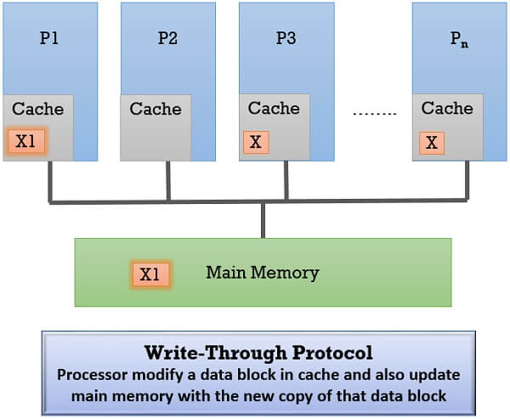

Slide 103
Write-Back Protocol
This protocol permits the processor to modify a data block only if it acquires ownership.
Steps to Acquire Ownership
Initially, the memory is the owner of all the data blocks and it retains that ownership when a processor reads a data block and sites its copy in its cache.

Slide 104
When a processor wants to modify a data block in its cache it has to confirm that it is an exclusive owner of that data block.
  For this, it has to first invalidate the copies of this data block in the other caches by broadcasting an invalidating request to all processors.
  Once it has become the exclusive owner, it can modify the data block.

Slide 105
If any processor wants to read this modified data block it has to send the request to the current owner processor of that data block.
The owner forwards the data to the requesting processor and to the main memory.
The main memory updates the content of the data block that has been modified and reacquires its ownership again over the data block.
If any processor requires this data block it will be serviced by the main memory.

